Slide 1
Documentation and Programming Style
Appendix A
© 2015 Pearson Education, Inc., Hoboken, NJ. All rights reserved

Slide 2
Naming Variables and Classes
Name should suggest use of variable
Follow practice/convention of other programmers
  Variable names start with lower case
  Class names start with upper case
  If variable has multiple words, each word starts with capital letter (“camel case”)
  Constant names in all caps
© 2015 Pearson Education, Inc., Upper Saddle River, NJ. All rights reserved

Slide 3
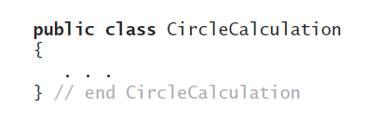
Indenting
Use indenting to indicate structure
  Makes program easier to read
Each class begins at left margin, uses braces to enclose definition
© 2015 Pearson Education, Inc., Upper Saddle River, NJ. All rights reserved

Slide 4
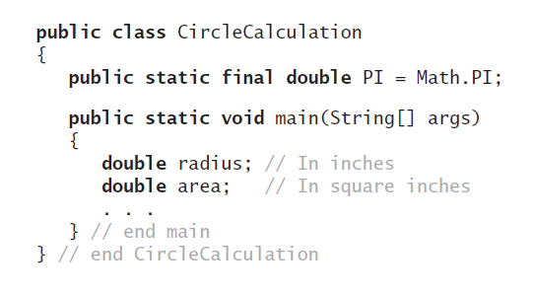
Indenting
Data fields and methods appear indented within these braces
© 2015 Pearson Education, Inc., Upper Saddle River, NJ. All rights reserved

Slide 5
Indenting
Each level of nesting indented from previous level to show nesting more clearly.
Outermost structure not indented at all.
© 2015 Pearson Education, Inc., Upper Saddle River, NJ. All rights reserved

Slide 6

Indenting
If statement does not fit on one line
  Write it on two or more lines.
When you write single statement on more than one line
  Indent the successive lines more than the first line
© 2015 Pearson Education, Inc., Upper Saddle River, NJ. All rights reserved

Slide 7
Indenting
NOTE:
  Java compiler does not care about indenting
  Java compiler DOES care about statements, indicated by a trailing semi-colon “;”
  Java compiler DOES care about blocks of statements, within curly braces “{“ and “}”
  Strings that are too long for a single line must be broken up with one string per line, connected by concatenation “+” (see previous slide)
© 2015 Pearson Education, Inc., Upper Saddle River, NJ. All rights reserved

Slide 8
Self Documenting
Documentation for a program describes what the program does and how it does it
Clean style, well-chosen names make program purpose and logic clear
Programs also need explanation to make completely clear.
  Given in the form of comments.
© 2015 Pearson Education, Inc., Upper Saddle River, NJ. All rights reserved

Slide 9

Comments
Single line comments
  Double slash
Comment blocks
  Enclosed by /* comments */
Javadoc comment blocks
  Enclosed by /** comments */
When to use comments
  Explanation at beginning of program
  What program does, name of author, date, etc.
© 2015 Pearson Education, Inc., Upper Saddle River, NJ. All rights reserved

Slide 10
Java Documentation Comments
Utility program named javadoc
  Generates HTML documents that describe your classes
Extracts
  Header for your class
  Headers for all public methods
  Comments written in a certain form
© 2015 Pearson Education, Inc., Upper Saddle River, NJ. All rights reserved

Slide 11
Java Documentation Comments
Conditions for javadoc to extract a comment
  Must occur immediately before public class definition or header of public method.
  Comment must begin with /** and end with */
Comments written for javadoc usually contain special tags
  Tag @author identifies programmer’s name, required of all classes and interfaces.
© 2015 Pearson Education, Inc., Upper Saddle River, NJ. All rights reserved

Slide 12
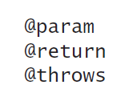
Java Documentation Comments
Other tags of interest to us are used with methods
  Must appear in following order within comment that precedes method header:
© 2015 Pearson Education, Inc., Upper Saddle River, NJ. All rights reserved

Slide 13

Java Documentation Comments
The @param tag.
  Written for every parameter in a method
  List these tags in order in which parameters appear in method’s header
Example tag
Resulting documentation
© 2015 Pearson Education, Inc., Upper Saddle River, NJ. All rights reserved

Slide 14
Java Documentation Comments
The @return tag
  Must write a @return tag for every method that returns a value
  Tag must come after any @param tags in comment
  Do not use this tag for void methods and constructors
© 2015 Pearson Education, Inc., Upper Saddle River, NJ. All rights reserved

Slide 15
Java Documentation Comments
The @throws tag
  If a method can throw a checked exception, name by using @throws tag
© 2015 Pearson Education, Inc., Upper Saddle River, NJ. All rights reserved

Slide 16
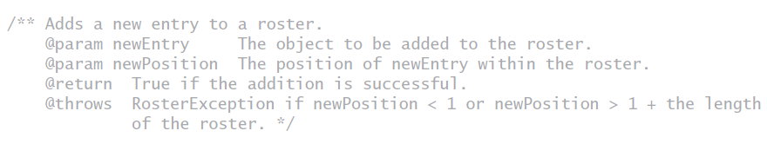
Sample javadoc Comments
NOTE: Eclipse automatically adds the applicable @ annotations when you type /**
© 2015 Pearson Education, Inc., Upper Saddle River, NJ. All rights reserved

Slide 17
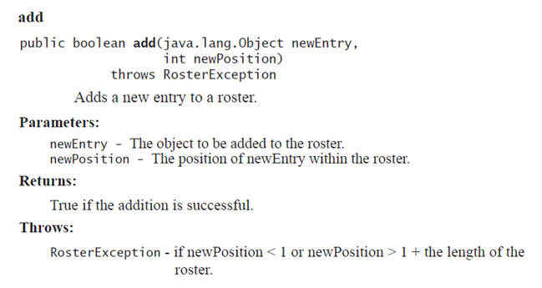
Resulting javadoc Output
© 2015 Pearson Education, Inc., Upper Saddle River, NJ. All rights reserved

Slide 18
Documentation and Programming Style
End
© 2015 Pearson Education, Inc., Upper Saddle River, NJ. All rights reserved

